Slide 1
How to concatenate multiple rows of the same field to one row
Yoel Kortick | Sept. 2024

Slide 2
Introduction
How is it done?
Let's do it

Slide 3
Introduction

Slide 4
Introduction
There may be cases whereby one specific field in an analytics report makes several rows appear for one "entity" such as a title.
Depending on the purpose of the report, it may be useful to concatenate these fields to one row and delimit them with a specific character such as a pipe (|).
On the next slide for example we see a report where for many of the titles there are several barcodes, and a new row is created for each barcode.
Instead of having a new row we may want to have all barcodes together.

Slide 5
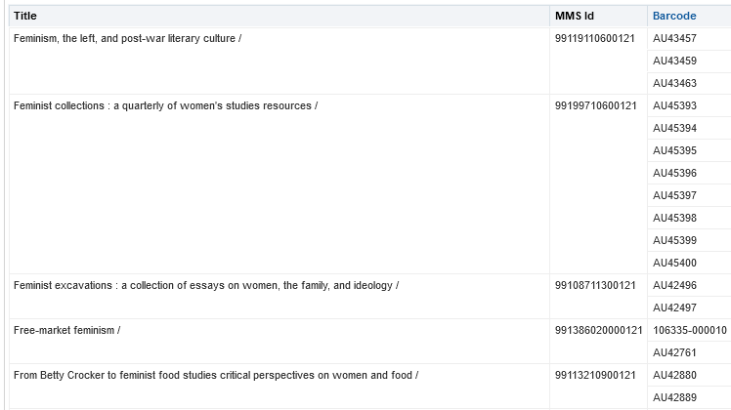
Introduction
Here we have 3 rows because there are 3 barcodes for one title
Here we have 7 rows because there are 7 barcodes for one title
Here we have 2 rows because there are 2 barcodes for one title

Slide 6
How is it done?

Slide 7
How is it done?
We will use a formula as follows instead of "folder name"."field name":
cast(EVALUATE_AGGR('LISTAGG(%1, %2 on overflow truncate) WITHIN GROUP (ORDER BY %1) ', "folder name"."field name", ' | ') as varchar(4000))
This will be the delimiter
So, for example instead of this
"Institution"."Institution Code"
We will have this:
cast(EVALUATE_AGGR('LISTAGG(%1, %2 on overflow truncate) WITHIN GROUP (ORDER BY %1) ',"Institution"."Institution Code", ' | ') as varchar(4000))

Slide 8
How is it done?
So, for example instead of this
"Physical Item Details"."Barcode"
We will have this:
cast(EVALUATE_AGGR('LISTAGG(%1, %2 on overflow truncate) WITHIN GROUP (ORDER BY %1) ', "Physical Item Details"."Barcode", ' | ') as varchar(4000))

Slide 9
Let's do it

Slide 10
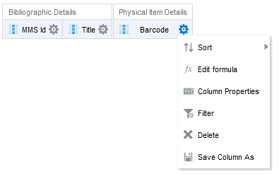
Let's do it
In the criteria tab of the report do "edit formula" on the desired field.
We will do it for barcode.

Slide 11
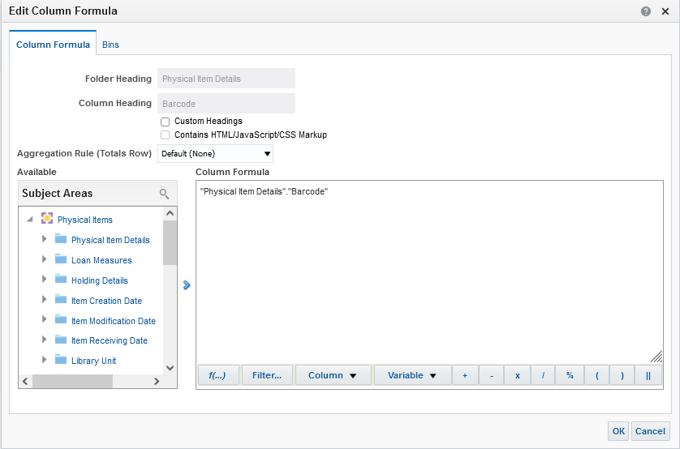
Let's do it
We see this

Slide 12
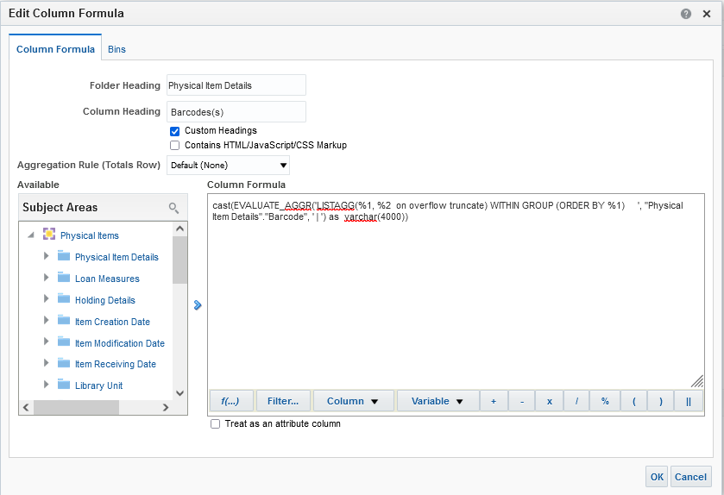
Let's do it
We change it to this
cast(EVALUATE_AGGR('LISTAGG(%1, %2 on overflow truncate) WITHIN GROUP (ORDER BY %1) ', "Physical Item Details"."Barcode", ' | ') as varchar(4000))
We also changed the column heading but that is not mandatory

Slide 13
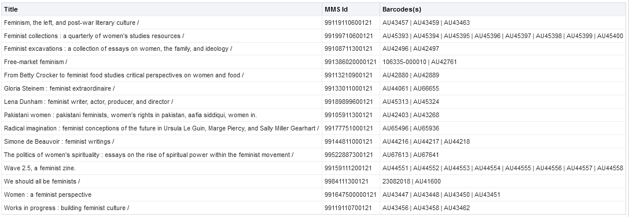
Let's do it
Now the report looks like this

Slide 14
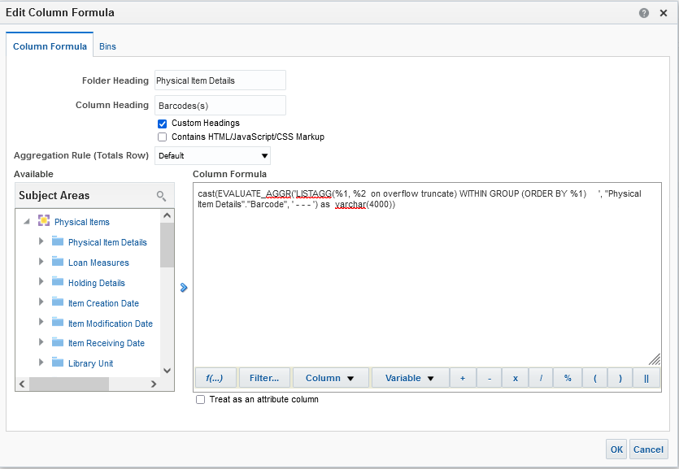
Let's do it
Instead of a pipe lets make the delimiter be three dashes

Slide 15
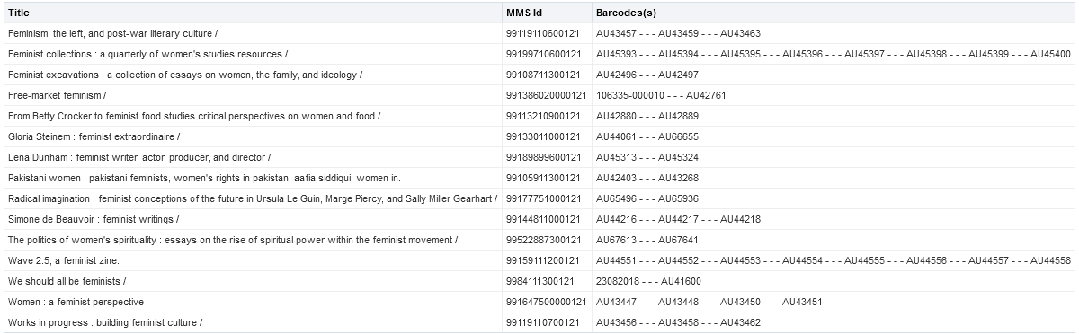
Let's do it
Now we have this:
The delimiter is no longer a pipe. It is three dashes.

Slide 16
Thank You.
Yoel Kortick

